Slide 1
Analysis of
World Development
Group F Members :
Akshaya Rajendran (Z1957049)
Gouri Patil (Z1931431)
Hita Gurunath Kadam (Z1908140)
Tejaswini Mode (Z1966081)

Slide 2
AGENDA :
Introduction
Data Set Details
Research Questions and Analysis
Conclusion
Interesting Stats !!

Slide 3
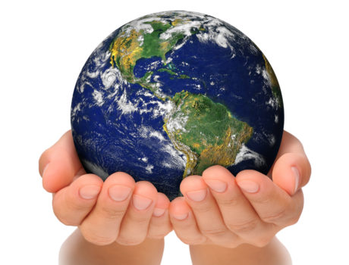
INTRODUCTION :
Analysis of current world trends based on financial growth, lifestyle
Countries based on socio-economic factors
The main factors considered:
GDP
Peace Index
Human Development Index
Gender Inequality

Slide 4
INTRODUCTION :
Data Source: https://databank.worldbank.org/
https://en.wikipedia.org/wiki/Gender_Inequality_Index
https://en.wikipedia.org/wiki/Global_Peace_Index
https://worldpopulationreview.com/country-rankings/hdi-by-country
Sample Size : 199 Variables : 32
Unit of Analysis : Country
Categorical Variables : HDI, GPI, GII, Region, IncomeGrp….etc
Continuous Variables : GDP, Unemployment_Rate, Life_Expectancy, Literacy, Control_of_Corruption….etc

Slide 5
Question 1 :
What factors contribute to the Human Development in a country?
Method : Multiple Linear Regression

Slide 6
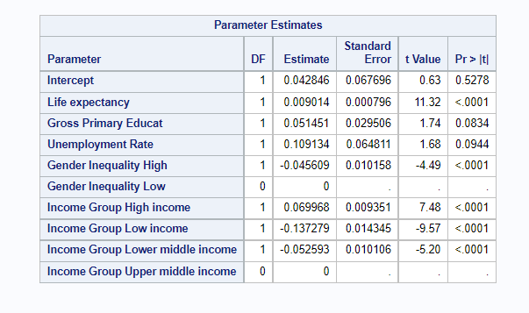
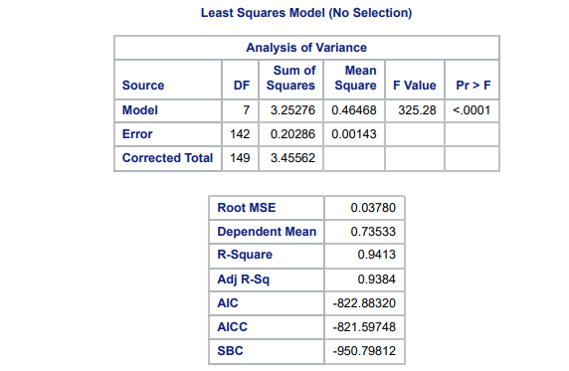
Model is significant.
93.84% is explained
Significant variables:
Life Expectancy
High Gender Inequality (negative)
High Income Group
Low Income Group (negative)
Lower-middle Income Group (negative)

Slide 7
Question 2 :
Whether Peace Quotient and Gender Inequality of a country depends on the Region it is located in?
Method : Chi-Square Test of Independence

Slide 8
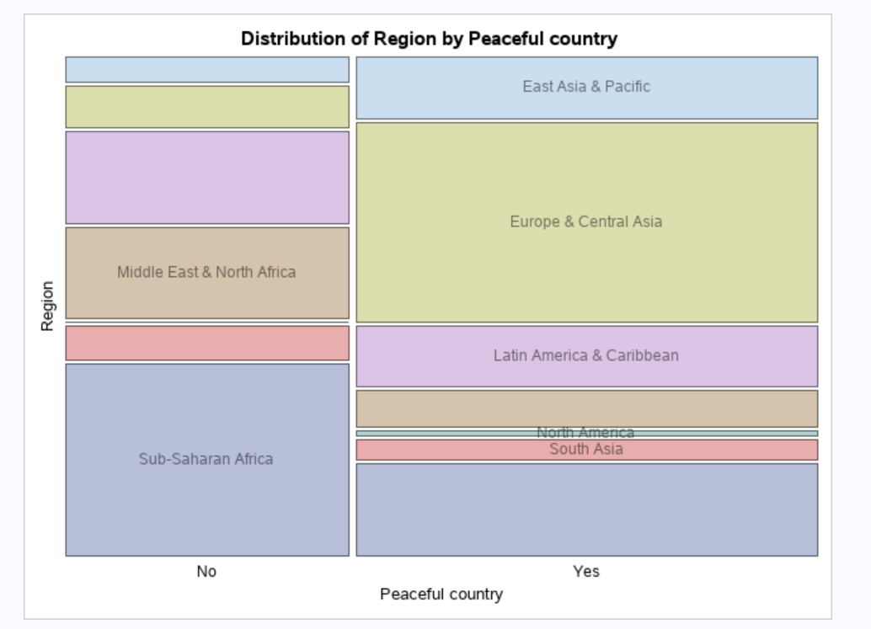
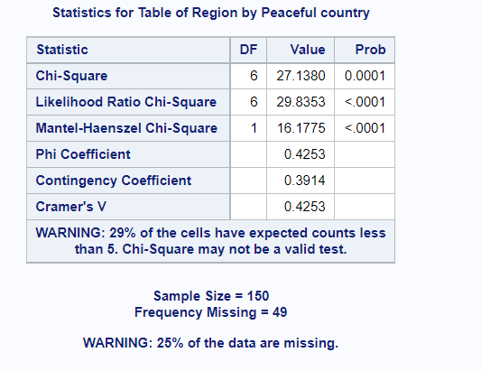
Region x Peace Quotient

Slide 9
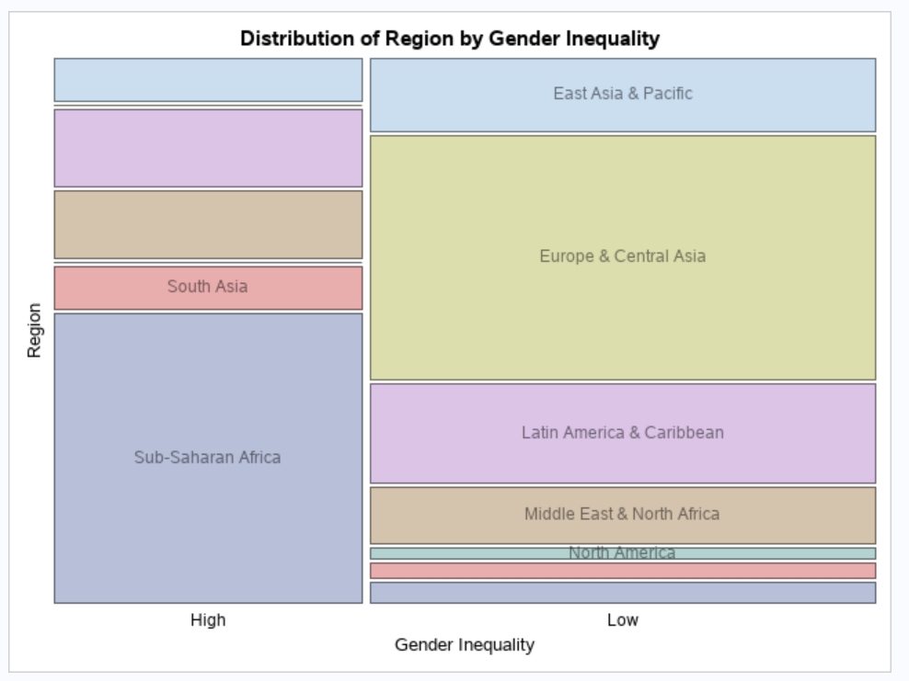
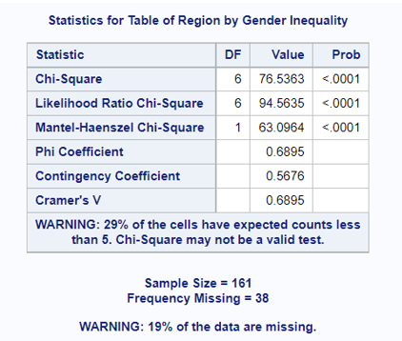
Region x Gender Inequality

Slide 10
Question 3 :
What variables influence the effectiveness of the government in a country?
Method : Binary Logistic Regression

Slide 11
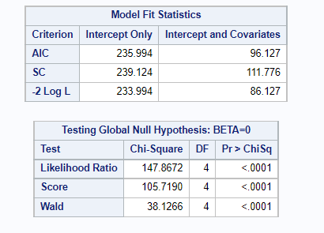
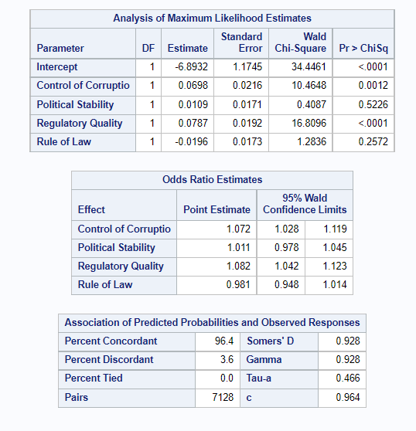
Model is significant.
96.40% of times, the prediction are correct
Significant variables:
Control of Corruption
Regulatory Quality

Slide 12
Question 4 :
Statistical factors for a country.
Method : Factor Analysis

Slide 13
No of factors : 5
1. Population related – Fertility Rate, Birth Rate, Population growth, HDI, Life Expectancy, Literacy Rate, Access to Electricity
2. Social Factors – Global Peace Index, Control of Corruption, Government Effectiveness, Political Stability, Absence of violence, Regulatory quality, Gender Inequality Index
3. Economic factors – GDP growth, Inflation-Consumer Price, Inflation-GDP deflator
4. Employment factors – Tax Revenue, Unemployment Rate, Death Rate, Rule of Law
5. Trade factors – Exports, Imports

Slide 14
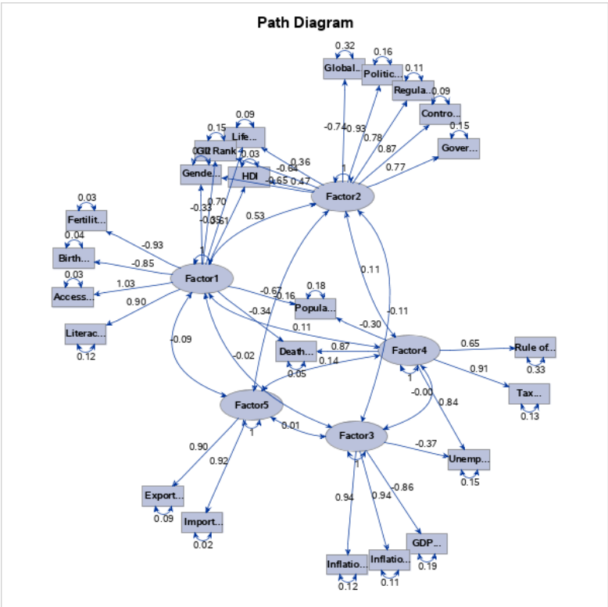

Slide 15
CONCLUSION :
No correlation between Developed countries and its peace index.
Political stability and Absence of Terrorism does not affect the government effectiveness of a country.
Gross Primary Education enrollment is not a key dimension for Human Development index.

Slide 16
INTERESTING STATS :
Iceland is the most peaceful country !!
Norway has low Gender Inequality and with high HDI !!
Singapore score a perfect 100 in terms of government effectiveness !!
Only 9 countries in the world possess nuclear weapons !!
Qatar has the lowest unemployment rate of 0.09% !!

Slide 17

THANK YOU

